Slide 1
Artificial Intelligence Club
Mr. Hatcher
1271

Slide 2
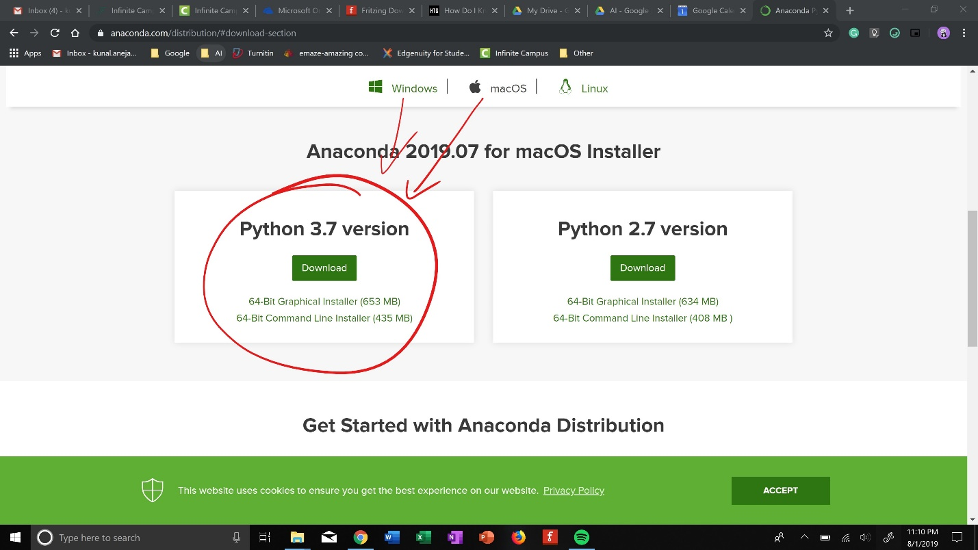
Installing Anaconda
https://www.anaconda.com/distribution/
Just search up anaconda download
** make sure you scroll down**

Slide 3
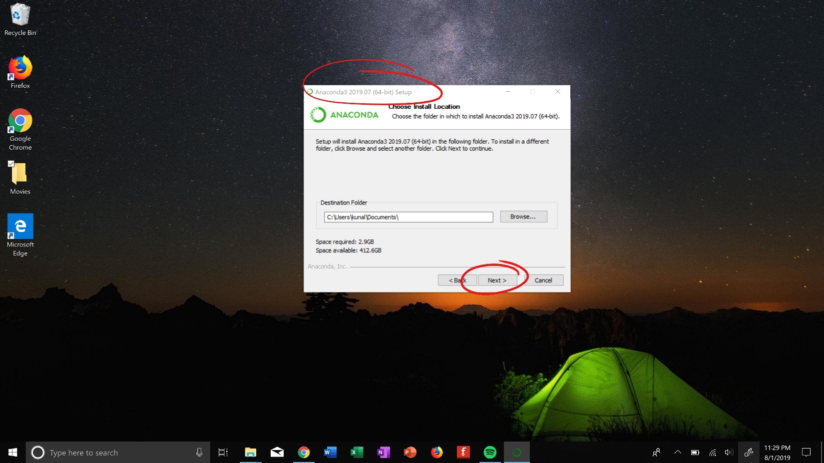
Installing Anaconda
Go through process SLOWLY
Pic a proper place to save it***

Slide 4
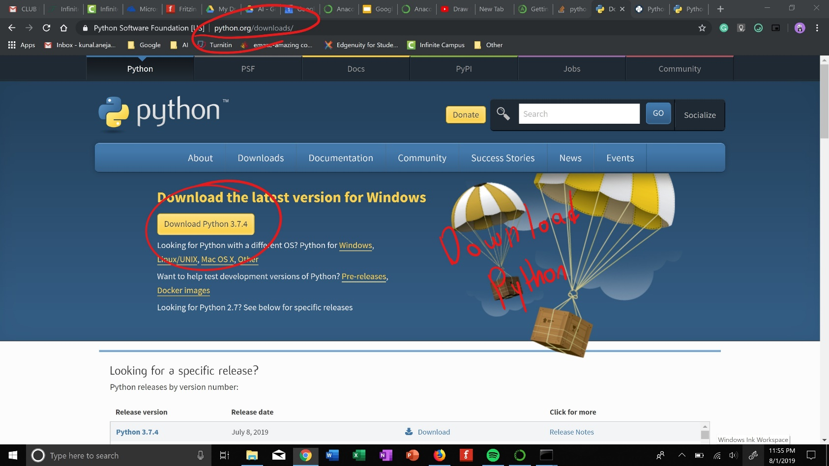
Installing Anaconda
Download Python
Just search it up

Slide 5
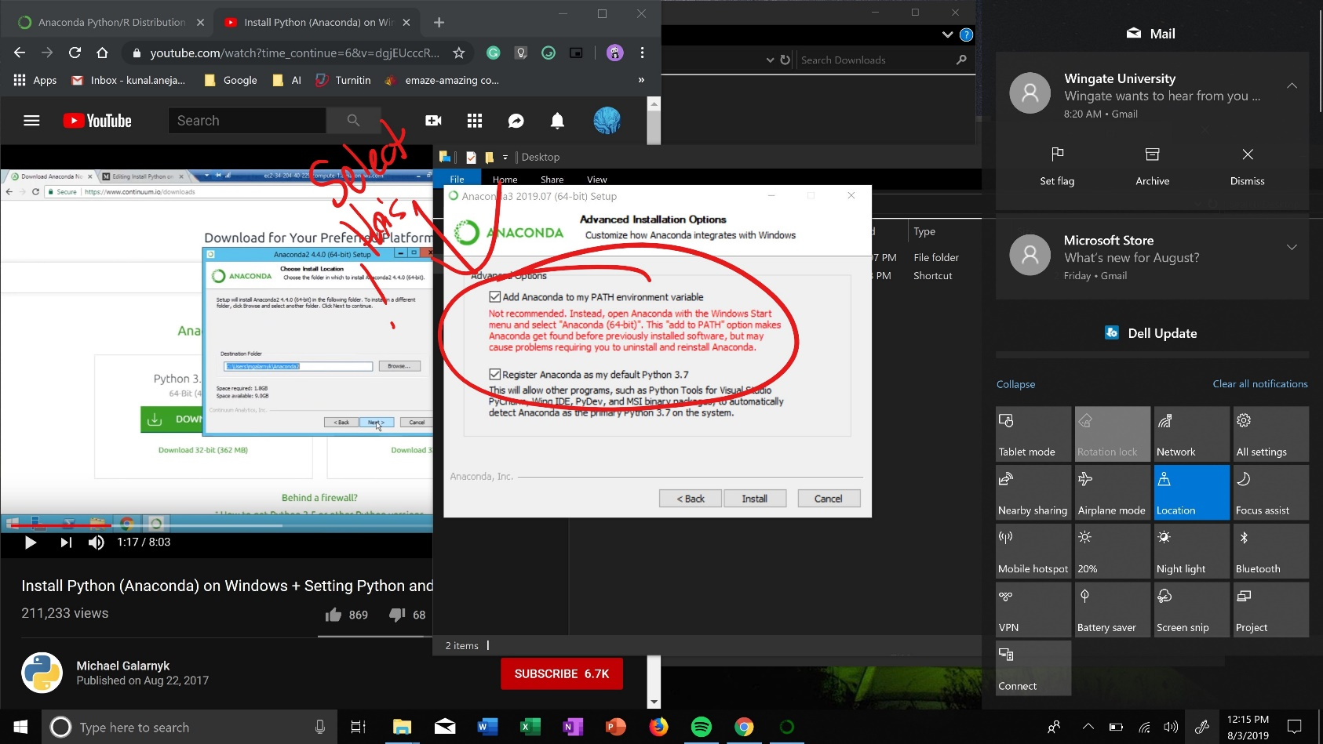
Installing Anaconda
MAKE SURE YOU DO THIS
ADD ANACONDA TO MY PATH ENVIORMENT VARIABLE

Slide 6
Running Anaconda
Go to command line and type in “jupyter notebook”
Make sure you have pip installed
Install all the libraries
https://www.youtube.com/watch?v=Fcc_jemaoNU

Slide 7
Google One
Place to store and run code on it
https://drive.google.com/open?id=1CArmByxi1DddcogwAhvehkiaSXNEYcL3

Slide 8
Last Year Cafeteria Project
Summary
https://www.youtube.com/watch?v=OxcCs7-fxUM&t=5s
Actual Demo
---

Slide 9
This Year Object Detection Car
https://www.nvidia.com/en-us/autonomous-machines/embedded-systems/jetbot-ai-robot-kit/?nvid=nv-int-csfg-33721#cid=internal_en-us_CORPSFG_Embedded-Robotics-EM03
4 different cars
Pick one
Main
https://www.sparkfun.com/products/15365

Slide 10
Nvidia Resources
Opensource Models
https://developer.nvidia.com/open-source
Demos
https://devtalk.nvidia.com/default/board/371/jetson-nano/

Slide 11
Nvidia Certification
https://www.nvidia.com/en-us/deep-learning-ai/education/
Fundamentals of Deep Learning for Computer Vision
Getting started with Jetson Nano

Slide 12
Sponsorships/Mentorship
Chick-fil-A
IBM
Amazon AWS
Microsoft
https://www.deepvisionai.com/

